Slide 1

Yes Bank Stock Price Prediction
Capstone Project
Kumar ankit

Slide 2

Outline
Introduction
Data Outline
Exploratory Data Analysis
Model Implementation
Model Comparison via evaluation metrics
Conclusion

Slide 3
Introduction
The "Yes Bank Stock Price Prediction" project aims to create a robust machine learning model for forecasting the future price movements of Yes Bank's stock. By analyzing historical stock data and relevant financial indicators, the project seeks to provide valuable insights for investors and traders. It involves data collection, preprocessing, and feature engineering to create informative input features. Various machine learning algorithms will be explored and evaluated to identify the most accurate predictive model. Time series analysis techniques will be employed to account for temporal patterns, and sentiment analysis of news and social media will be integrated to capture market sentiment. The project's outcome will be a user-friendly interface for real-time predictions, fostering informed decision-making. The project's significance lies in its potential to assist stakeholders in navigating the complexities of stock trading by providing reliable forecasts and enhancing understanding of key factors influencing Yes Bank's stock prices.
Yes Bank is a well-known bank in the Indian financial domain. Since 2018, it has been in the news because of the fraud case involving Rana Kapoor. Owing to this fact, it was interesting to see how that impacted the stock prices of the company and whether Time series models or any other predictive models can do justice to such situations. This dataset has monthly stock prices of the bank since its inception and includes closing, starting, highest, and lowest stock prices of every month.
Our main objective is to predict the stock’s closing price of the month.

Slide 4
Data Outline
Explaining the data:- We have a dataset containing values of Yes bank monthly stock prices as mentioned in our problem statement.
Explaining the features present :-
Date :- The date (Month and Year provided)
Open :- The price of the stock at the beginning of a particular time period.
High :-The Peak(Maximum) price at which a stock traded during the period.
Low :-The Lowest price at which a stock traded during the period.
Close :- The trading price at the end (in this case end of the month).

Slide 5
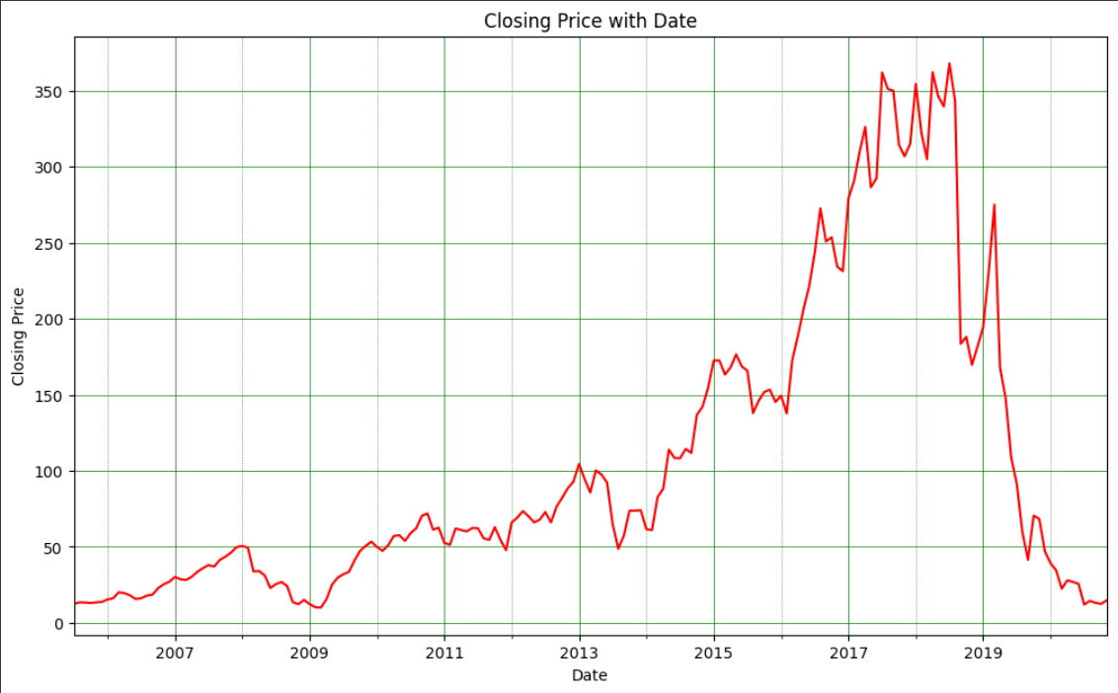
EDA: Visualizing our dependent variable
The Graph demonstrates how closing price varies with each passing year.
We can see that the stock price is rising up until 2018 when the fraud case involving Rana Kapoor happened after which the stock price has had a sharp decline.

Slide 6
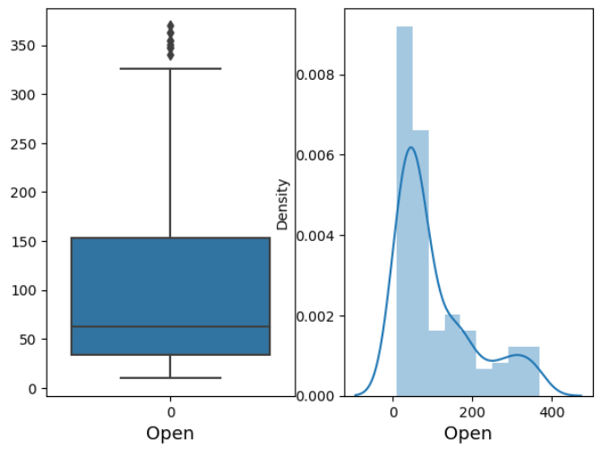
Checking for outliers
As we can clearly see in the figure that our variables have some outlier.
And it is also positively skewed
Same case as this we are getting for other variables
Next we will remove this outlier and make it normally distributed by using log transformation on all the variables.

Slide 7
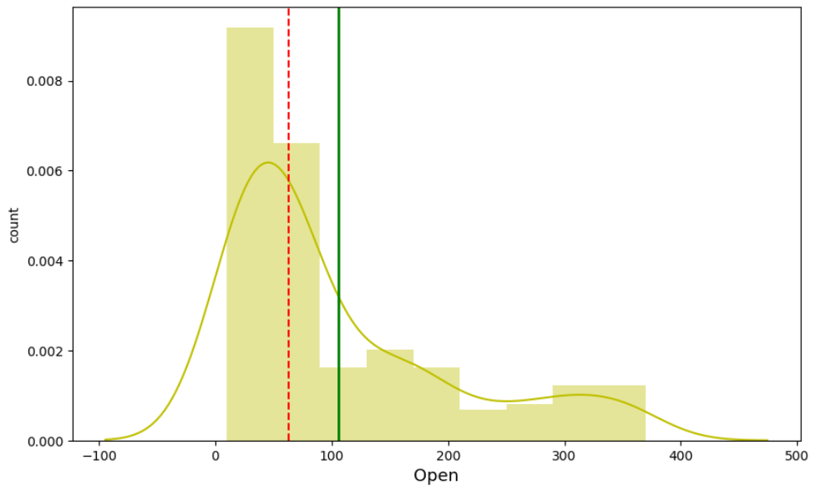
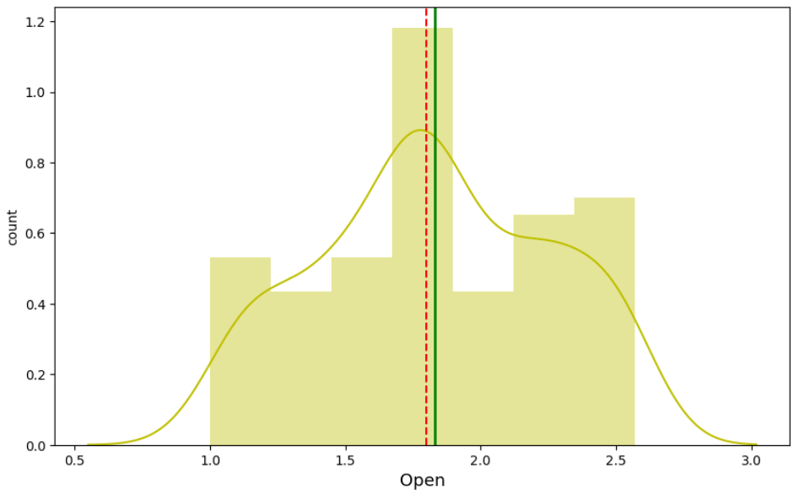
Plotting the dependent variable . We can see that our dependent variable close to positively skewed.
So we do a log transformation on it and plot it as seen in the right chart. This makes it approximately normal distribution and is optimal for our model’s performance. Now our mean and median are nearly equal and this we will do for all the other variables.

Slide 8
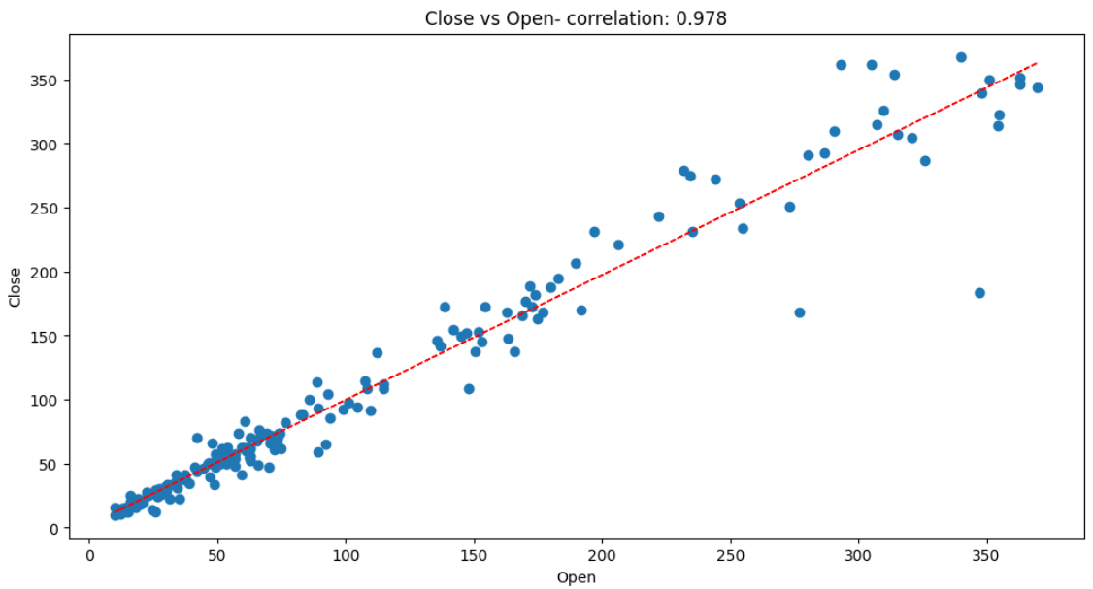
Visualizing data distribution
As we can see that there is linear relation and high correlation between each independent variables and our dependent variable.
Also we can see that the value of correlation between dependent variable Close and feature Open approximately 0.978

Slide 9
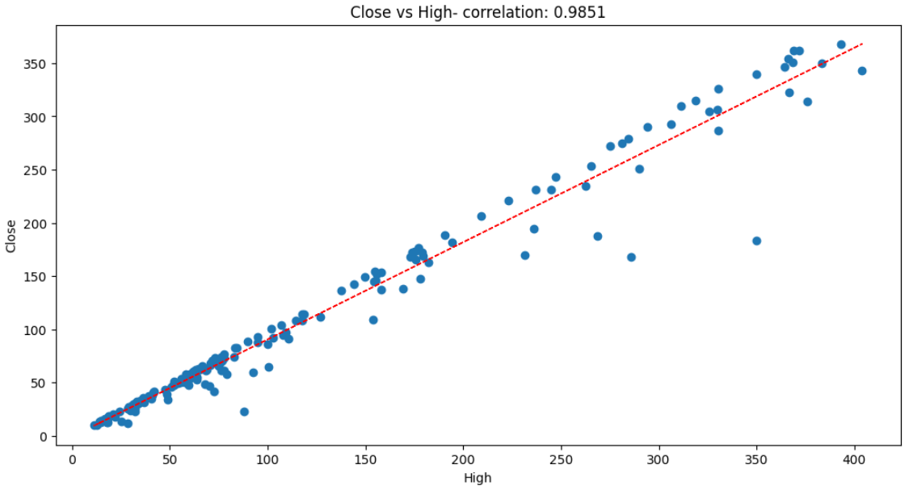
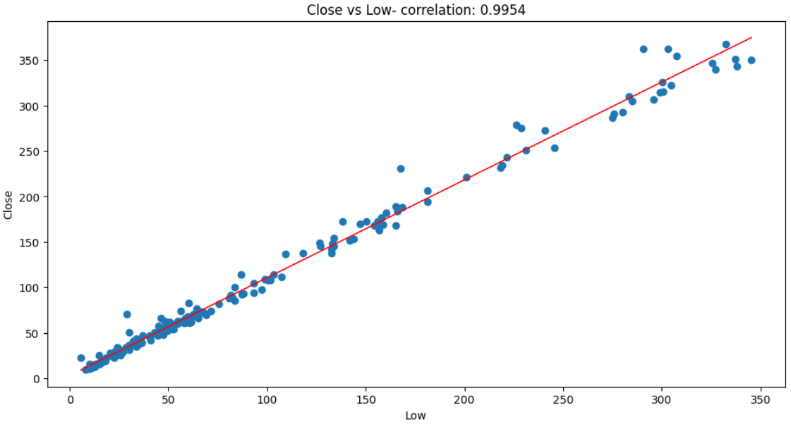
As we can see that there is a linear relation and very high correlation between our dependent variable and independent variables. The value of correlation between Close and High is 0.9851 and b/w Close and Low is 0.9954

Slide 10
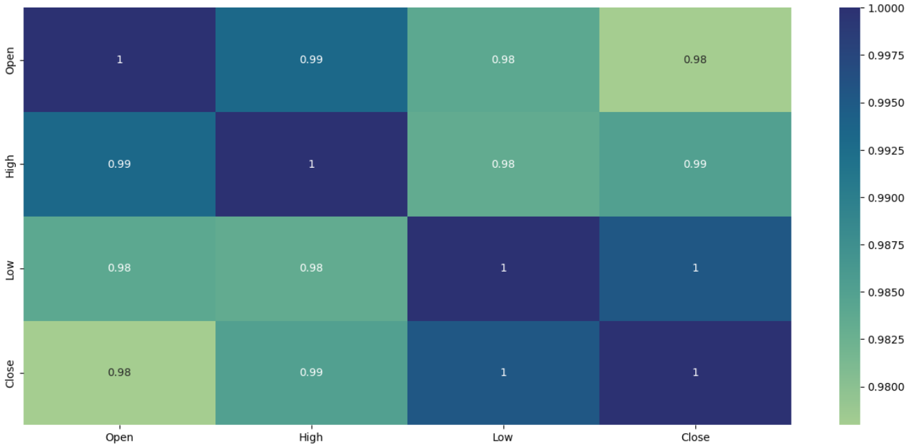
Correlation Heatmap
The correlation matrix helps us visualize the correlation of each parameter with respect to every other parameter.
The colors changes from blue to red for highest to the lowest correlation values and vice versa.
We can see in the heatmap on this slide that our dependent variable (close price) is highly correlated with all the other independent variables

Slide 11
Model Implementation
Based on the linear relationship between the dependent and independent variables present in our data, we implemented following models on our data.
Linear Regression
Lasso Regression with Cross-validation
Ridge Regression with Cross-validation
Elastic Net Regression with Cross-validation
We fit these models on training data, learn the model parameters and then make predictions on test dataset. Then we check the performance of these models using various evaluation metrics such as :-
Mean Absolute error.
Mean squared error and RMSE
R-squared and Adjusted R-squared
Finally, we select the best performing model based on these metrics.

Slide 12
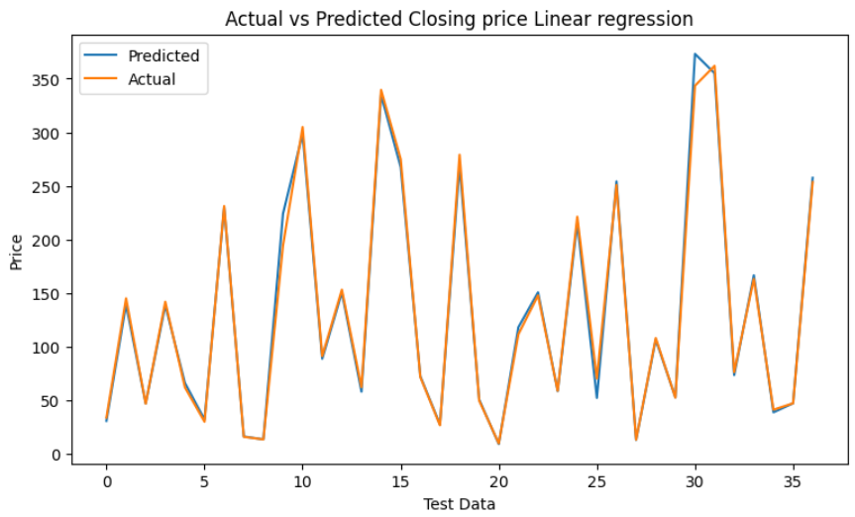
Visualizing our actual and predicted value
Our simple Linear Regression Model predicted the closing price with Root Mean squared error(RMSE) of 8.3917
R2 score of this model is 0.9937
Adjusted R2 score has the value 0.9930 for this model. Which tells us that around 99.3 percent of the variance in our dependent variable is attributable to the independent variables.

Slide 13
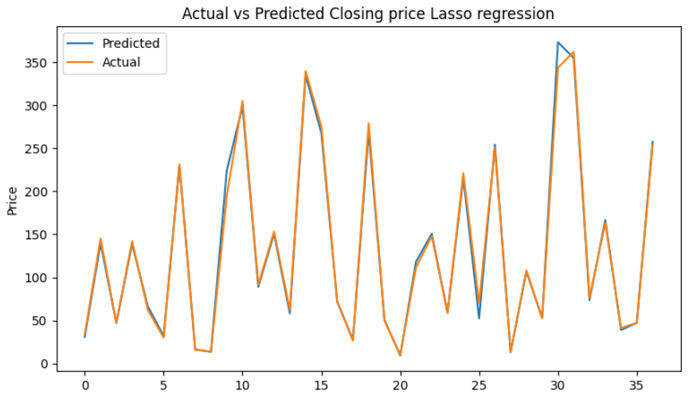
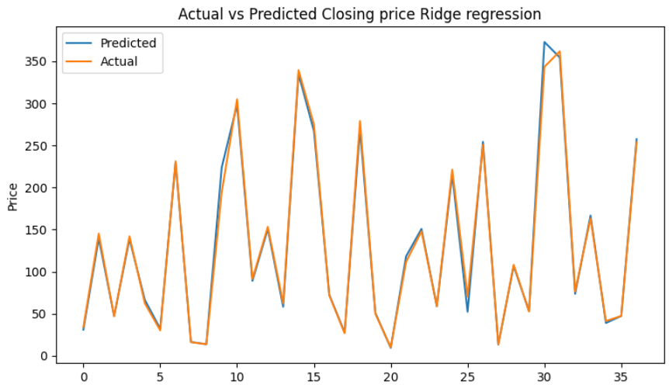
Lasso Regression
RMSE- 8.3864
R2 Score – 0.9938
Adjusted R2 score has the value 0.9932 for this model. Which tells us that around 99.32 percent of the variance in our dependent variable is attributable to the independent variables.
Ridge Regression
RMSE- 8.3824
R2 Score – 0.9938
Adjusted R2 score has the value 0.9932 for this model. Which tells us that around 99.32 percent of the variance in our dependent variable is attributable to the independent variables.

Slide 14
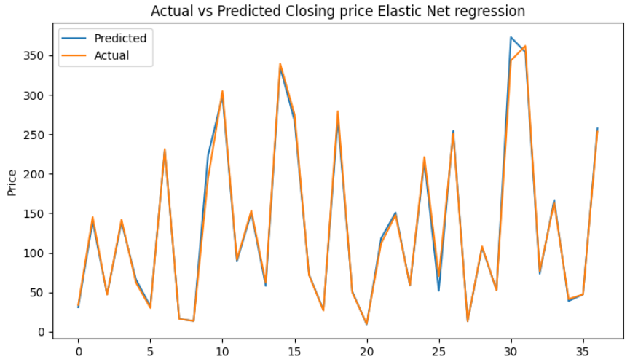
Elastic Net Regression
RMSE- 8.3760
R2 Score – 0.9938
Adjusted R2 score has the value 0.9932 for this model. Which tells us that around 99.32 percent of the variance in our dependent variable is attributable to the independent variables.

Slide 15
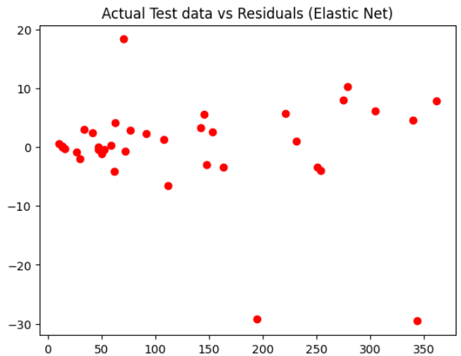
Checking actual and residuals
In the graph, I have plotted the residuals (actual value - predicted) against the predicted values of our best performing model - Elastic Net regression. This is to check whether Heterodasceticity is present in our data or not. Since the data is symmetrical around zero, we can safely say that there is no heterodasceticity in our data. Hence the assumption of linear regression is valid here.

Slide 16
Evaluation Metrics
Metric | Linear Regression | Lasso | Ridge | Elastic Net
MAE | 4.8168 | 4.8262 | 4.8334 | 4.8483
MSE | 70.4204 | 70.3311 | 70.2641 | 70.1569
RMSE | 8.3917 | 8.3864 | 8.3824 | 8.3760
R2 Square | 0.9937 | 0.9938 | 0.9938 | 0.9938
Adjusted R2-Square | 0.9930 | 0.9932 | 0.9932 | 0.9932
We can clearly see from the table above that the best performing model is elastic net as it has higher accuracy and least error value.

Slide 17
Conclusion
There is a high correlation between the dependent and independent variables. This is a good thing as
we can make really accurate predictions using simple linear models.
We implemented several models on our dataset in order to be able to predict the closing price and found that Elastic Net regressor is the best performing model with Adjusted R2 score value of 0.9932 and it scores well on all evaluation metrics.
All of the models performed quite well on our data giving us the accuracy of over 99%..We found that there is a rather high correlation between our independent variables. This multicollinearity however is unavoidable here as the dataset is very small.
We found that the distribution of all our variables is positively skewed. so we performed log transformation on them.
Using data visualization on our target variable, we can clearly see the impact of 2018 fraud case involving Rana Kapoor as the stock prices decline dramatically during that period.
With our model making predictions with such high accuracy even on unseen test data, we can confidently deploy this model for further predictive tasks using future real data.
Thank You

